Slide 1


NOVEMBER 2016 HIGHLIGHTS

Slide 2


NOVEMBER
MIS TV: Mysteries that leave us with good taste.
November once again, but not in any way. This month brings us a selection of music, among others, whose songs sweeten a dramatic years of the Civil War and Postwar. Love, heartache, and especially a lot of mystery will do this month a very special one.
"The past is history and future is a mystery“. November comes with great Films that explain us both sides. ¡Don’t miss it!

Slide 3


EL AÑO DE LAS LUCES
Director: Fernando Trueba (1986)
Comedy.
Cast: Jorge Sanz, Maribel Verdú, Veronica Forqué, Manuel Alexandre, Rafaela Aparicio, Santiago Ramos, Chus Lampreave, José Sazatornil, Violeta Cela…
April, 1940. Manolo, 16 years old, and Jesus, who is just 8, are taken by their older brother Pepe, a lieutenant in the Army, to a sanatorium for children suffering from tuberculosis, situated on the border with Portugal. Once in the sanatorium, Manolo, surrounded by boys all much younger than he is, feels a bit like the cock of the walk since the only other man around is the handyman Emilio who looks after the gardens and does whatever needs to be done about the place. Manolo meets Irene, a falangist who runs the sanatorium, and the school teacher, Miss Transito, a crabby spinster. He has his first sexual experience, albeit as a voyeur, with his nurse Vicenta. When she has to leave, her place is taken by a girl from the village, Maria Jesus, with whom Manolo falls hopelessly in love. A relationship grows up between them which will mark them both for ever.
Best supporting actress Oscar (Verónica Forqué): 1986

Slide 4

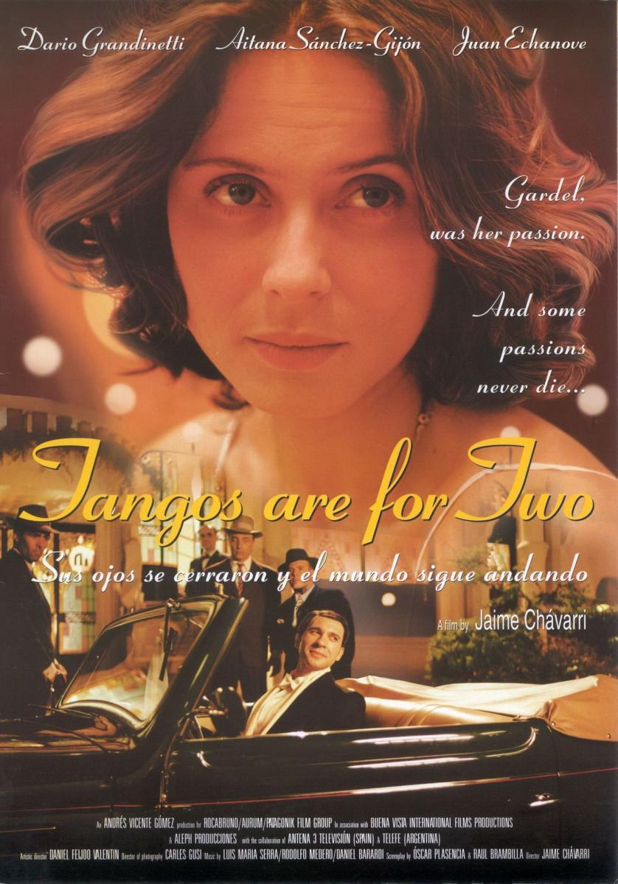
SUS OJOS SE CERRARON
Director: Jaime Chavárri (1997)
Musical-Drama
Cast: Darío Grandinetti , Aitana Sánchez-Gijón , Juan Echanove, Ulises Dumont, Raúl Brambilla , Carlos Carella y Ramón Rivero, entre otros.
A woman's voice says she was wife to Renzo Franchi and Carlos Gardel (1890-1935), Argentina's great tango singer. People say she's crazy. Her story unfolds. Buenos Aires, 1933: Juana Romero, a seamstress who lives for the music of Gardel, dumps her boyfriend Gustavo for Renzo, a singer who looks like Gardel. She insists that his trio performs Gardel's tangos, which leads to Renzo recording a Ford commercial when Gardel himself is overbooked. The trio, with Joanna in tow, goes on an ill-fated tour of points north. The couple breaks up: she goes home and he tries to get to New York. Fate steps in, and once again he's called upon to pose as Gardel. Then, legend and a bracelet take over.

Slide 5

BELTENEBROS
Director: Pilar Miró (1991)
Drama
Cast: Patsy Kensit, Terence Stamp, Jose Luis Gomez, Geraldine James, Simon Andreu, Aleksander Bardini, Jorge de Juan, John McEnery, Carlos Hipólito, Pedro Díez del Corral
In 1946, Darman followed orders from his Communist Party superiors, and went to Spain to kill someone the party had designated as a traitor, and he hasn't been comfortable with himself ever since. Now, it is 1962, and he receives word that he is wanted to perform a similar service. Obediently, he leaves his cozy, book-lined cottage in Britain and heads to Poland, where he gets his orders in some detail. Then he heads for Madrid, evading the Falangist regime's police forces and contacting the city's underground communists. He continues going through the motions of locating his victim, even though he is still very ambivalent about his assignment. At the end, he gets off the hook because another communist does the job. The complex situation grows more complex, leading to a final shootout. This political thriller is based on a novel by Antonio M. Molina and was quite well received in Spain.
Goya awards: best photography and special effects

Slide 6
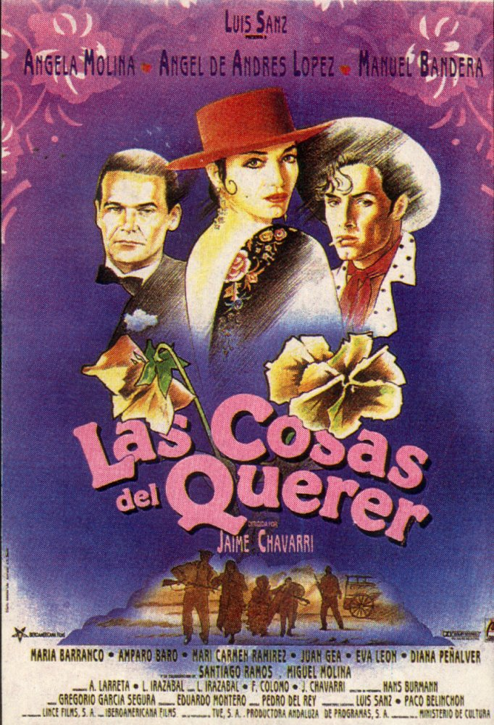

LAS COSAS DEL QUERER
Director: Jaime Chavárri (1989)
Musical-Melodrama
Cast: Ángel Molina, Ángel de Andrés Lopez, Manuel Bandera, Amparo Baró, Santiago Ramos, María Barranco
In 1940's Madrid. Juan plays piano for Pepita and her on-stage partner Mario. Although Mario really wants to steal Juan for himself, Juan is not interested and Mario resorts to a string of lovers as consolation. When he loves (and leaves) a young nobleman, the young man wants revenge.
Goya Awards: 7 nominations including Best Actress (Angela Molina)

Slide 7

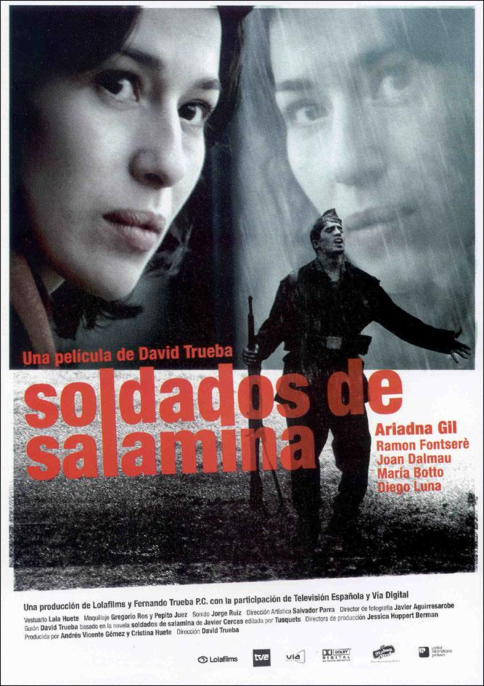
SOLDADOS DE SALAMINA
Director: David Trueba (2003)
Drama-Intriga
Cast: Ariadna Gil, Ramón Fontserè, Joan Dalmau, María Botto, Diego Luna, Alberto Ferreiro, Luis Cuenca, Vahina Giocante
When the professor and writer Lola Sánchez is assigned to write a column in the newspaper about the Spanish Civil War, she researches and finds for the first time about the shooting of Rafael Sánchez Mazas. Lola has lost her passion for writing, and she becomes intrigued about Rafael. When the lefts won the election in 1936, the Falange became illegal, and later there was a military coup d'stat. Rafael miraculously escaped from the shooting and was spared by an unknown soldier. Lola decides to write a book about the historic event and to disclose the identity of the unknown soldier. But her acquaintance Conchi advises that her work is affected by her lack of passion. Lola becomes obsessed to find him and see of he is connected to the event.
Goya Awards: Best photography: 8 nominations

Slide 8

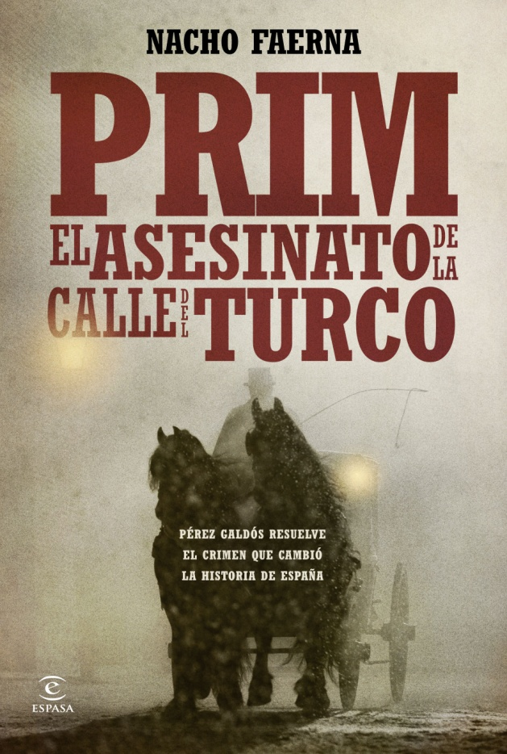
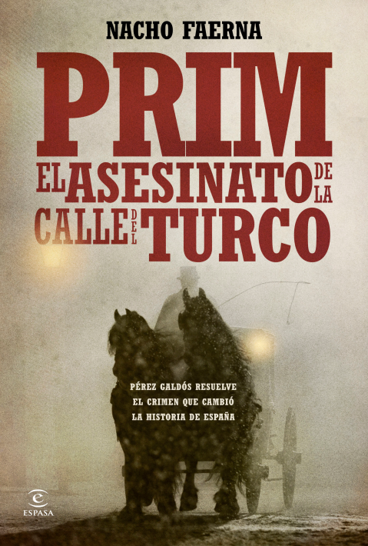
PRIM, EL ASESINATO DE LA CALLE DEL TURCO
RTVE- (2014)
Drama- Thriller
Cast: Francesc Orella, Javier Godino, Daniel Grao, Victor Clavijo, Simón Andreu, Pedro Casablanc, Secun de la Rosa, Jose Luis Alcobendas, Alfonso Lara, Yuriria del Valle, Enrique Villén, Javivi, Francesc Luchetti, Manolo Solo
Prim: Murder in Turk's Street narrates all the events and circumstances surrounding the murder of General Joan Prim i Prats—military hero, President of the Council of Ministers and a Minister of War—on 27 December, 1870, while on his way to his official residence after attending a Spanish Parliament session. Prim’s assassination, which has frequently been compared to that of John F. Kennedy, was never solved.

Slide 9
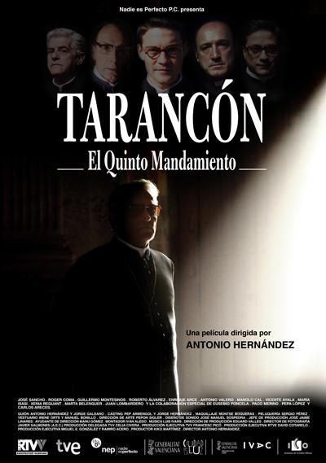
TARANCÓN
Drama
RTVE (2011)
Cast: José Sancho, Roger Coma, Eusebio Poncela, Roberto Álvarez, Paco Merino, Guillermo Montesinos, Carlos Areces, María Isasi, Enrique Arce, Antonio Valero, Marta Belenguer, Francisco Merino, Manolo Cal, Pepa López
Biographical miniseries about Cardinal Tarancon, a key figure in the time of transition for his efforts to reconcile the "two Spains". The killing by ETA of Luis Carrero Blanco, December 20, 1973, from Madrid leads the Cardinal, who is threatened with death. Once away from the city, Tarancon remember what life was like when he was a young fugitive priest during the Civil War (1936-1939).

Slide 10

LA REGENTA
RTVE (1995)
Drama.
Cast: Aitana Sanchez Gijón, Hector Alterio, Carmelo Gómez, Juan Luis Galiardo, Manuel Alexandre, Cristina Marcos, Francisco Merino, Amparo Rivelles, Miguel Rellán, Fiorella Faltoyano, José María Caffarel, Teresa del Olmo, Virginia Mataix, María Luisa Ponte, Juan José Otegui, Francisco Merino.
The Regent is a television miniseries adaptation of the novel by Leopoldo Alas "Clarin", written and directed by Fernando Méndez-Leite and issued by Spanish Television in 1995. On 30 March 2009 the series was re-released on the website Radio Spanish Television, 1 where you can see all the chapters and unabridged permanently.

Slide 11
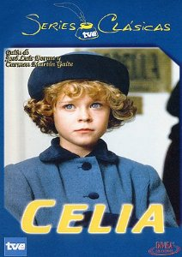
CELIA
RTVE (1993)
Drama. Comedy
Cast: Cristina Cruz Mínguez, Ana Duato, Pedro Díez del Corral, Adela Armengol, Sian Thomas, Miguel Magaña, Alito Rodgers, Concha Salinas, Carmen Rossi, Concha Leza, Aurora Redondo, Tito Valverde, Diana Salcedo, Eduardo Calvo, Luz María Gómez
Celia is an upper-middle-class, seven-year-old girl living in Madrid with her parents during the early 20th century. Celia, however, is not an ordinary child; she simply will not take adults for granted, nor will she stop questioning everything and everyone around her. With the only help of her acute sensitivity and high imagination, she will create a world of her own, a world available only to those who are willing to give it a chance.

